Slide 1


Department of Computer Science and Engineering
Improved Bone Cancer Diagnosis: Transfer Learning Integration with U-Net for Segmented Histopathology Image Analysis
Mr.Deepak Kumar K
Assistant Professor
Madhulika G - 210701139
Mahalakshmi K - 210701143

Slide 2
Problem Statement and Motivation
Bone cancer detection is crucial for successful treatment, but it is still difficult because of the limitations of traditional methods, which depend on manual analysis by radiologists and are prone to errors and inefficiencies. By creating a diagnostic tool that combines modern machine learning algorithms with powerful image processing techniques, this study seeks to address these issues. The project aims to enable earlier and more trustworthy diagnoses by increasing the efficiency and accuracy of bone cancer detection using medical pictures, thereby improving patient care and raising survival rates. This advancement is motivated by the need to overcome the limitations of existing methods and provide a more effective solution for bone cancer detection.

Slide 3
Objectives
Accurate and efficient diagnosis using advanced machine learning algorithms and image processing
Decrease time for detection and to focus on the further treatment process.
Image processing to extract the important features.
Improve the performance of the machine learning algorithm to effectively detect the cancerous cells.

Slide 4
Abstract
Bone cancer, while rare, poses significant health challenges with often late diagnoses.Though CNN, proposed as a good algorithm for classifying and detecting cancer from images, it faces challenges when it is a histopathological image. This study introduces a novel approach combining machine learning with cutting-edge image processing methods to increase the precision and effectiveness of diagnosis. The model retains several key features.Utilizing U-Net for segmentation and four different CNNs, ResNet50, VGG16, MobileNetV2, and DenseNet121 for classification, along with data augmentation strategies, our method aims to enhance the reliability of bone cancer detection. Preliminary results demonstrate improved performance in accuracy and speed compared to traditional methods.

Slide 5
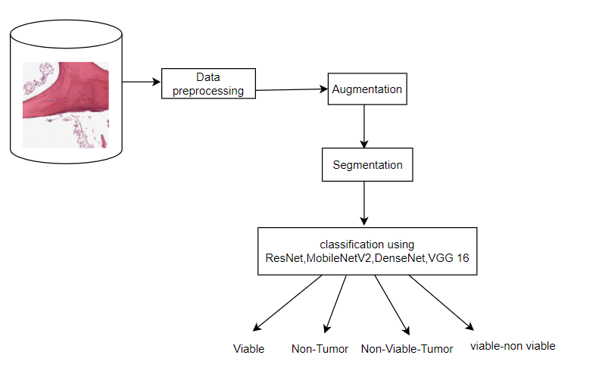
System Architecture

Slide 6
List of Modules
Data Collection
Exploratory data analysis
Data preprocessing
Data augmentation
Segmentation
Classification using variants of CNN algorithm (Transfer Learning)

Slide 7
Functional Description
Data Collection: The collection of precise as well as valid data is essential for model's training in order to get the highest level of classification accuracy that makes the model more credible. This study uses the publicly accessible data set in which bone cancer images can be found as histopathological photos. After collecting data, preliminary processing is carried out to transform the images to a form which the model may accept as input.Data is first divided into four folders illustrating four classes: non-tumor, non-viable-tumor, viable and viable_non-viable respectively. Afterwards, data is separated into train and test data with a proportion of 80:20.

Slide 8
Functional Description
Exploratory Data Analysis: After collecting the data it is further analyzed for better performance of the system.There are four classes of bone cancer they are non-tumor, non-viable-tumor, viable tumor and viable_non-viable tumor.From the observation of analysis it was found that the other classes except non-tumor was undersampled.The performance of the model depends on the data used for training.Minimizing the maximum data and maximizing the minimum data may lead to loss of important features.

Slide 9
Functional Description
Data Augmentation: A range of data augmentation procedures were utilized to decrease overfitting by increasing the training dataset's effective size and improve our model's generalizability. Since medical imaging data is not readily available for the diagnosis of bone cancer, augmentation is essential in recreating real-world deviations commonly found in medical scans. Among the augmentation techniques were random rotations to mimic different scan orientations, flipping (horizontally and vertically) to account for mirrored or inverted scans, and scaling to introduce variation in the size of regions of interest.

Slide 10
Functional Description
Segmentation:U-Net: An encoder-decoder structure is used which will not only generate the class labels but generates masks that are of same dimensions as input images, by eliminating need for a fully connected network making it useful for the identification of what is in the image.The encoder framework consists of four encoder blocks,each including an activation function of ReLU after two layers of convolution with a valid padding and 3x3 kernel size.The result is sent into a 2x2 kernel-sized max pooling layer, which splits learnt spatial dimensions into half and lowers the training cost of the model.

Slide 11
Functional Description
DenseNet121 is a densely connected CNN. It has a dense block ,transition layer which reduces the number of channels without losing the feature. In this model every layer gets input from the preceding layer.Each layer shares the knowledge gained which reduces the duplication of the calculation and makes it easy for the model to learn.
Residual Network is a deep learning model that was aimed to help train deeper neural networks. It does so by exploiting some pathways called “skip connections” which enable information to leap across some layers.One of the issues, which can occur in deep networks, can be fixed, for instance, one can lose information as it passes through layers.

Slide 12
Functional Description
VGG 16 is a deep learning model, used for image classification and it consists of a systematic design structure with multiple convolution and pooling layers consecutively. Following the multiple convolutional blocks the feature maps are flattened and fed to fully connected layers, the ones which do the reasoning and classification.
MobileNetV2 is a deep neural network architecture suitable for use in low power platforms Depthwise separable convolutions are applied which decrease load while increasing accuracy. Its main idea is an inverted residual building block that allows carefully preserving the features of the data during the transformation.

Slide 13
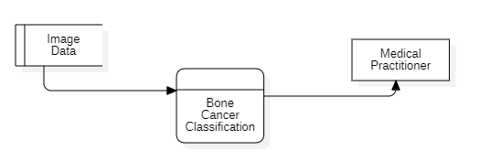
DFD Diagram
Level 0

Slide 14
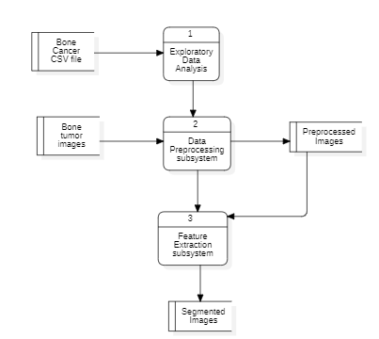
DFD Diagram
Level 1

Slide 15
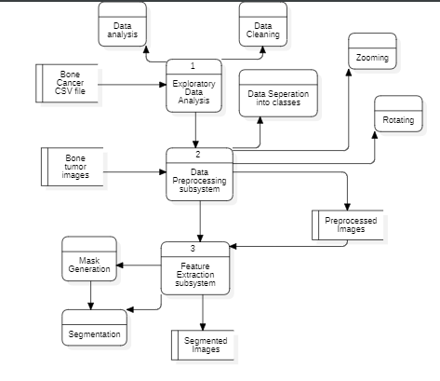
DFD Diagram
Level 2

Slide 16
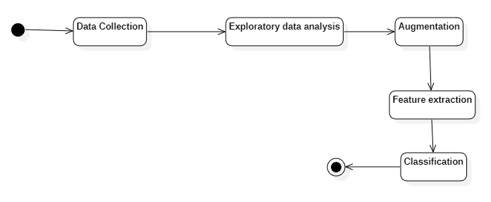
Activity Diagram

Slide 17
Implementation & Results of First Module
TensorFlow and Keras were used for data augmentation after EDA using numpy was used to check for disparities in classes in the data cleaning.
Tensorflow and Keras were used for the classification of images using the transfer learning algorithm and segmentation using Unet.
Model/Metrics | Accuracy | Precision | Recall | F1-score
MobileNetV2 | 75.93 | 76.10 | 75.93 | 75.96
DenseNet121 | 80.01 | 79.96 | 79.88 | 79.85
VGG16 | 73.96 | 73.79 | 73.96 | 73.44
ResNet50 | 57.50 | 60.59 | 57.50 | 58.25

Slide 18
Conclusion & Work for Phase II
When performing EDA in this project, we realized that we have a huge class imbalance problem in the provided dataset. To this end, we used some data augmentation strategies as rotation, flipping, and zooming in order to augment the data set and reduce overfitting of the model. First, the histopathology images were selected and segmented using the U-Net to obtain features of interest and classify them using other models including ResNet50, VGG16, MobileNetV2, and DenseNet121. By comparing the results obtained by distinct models, it was possible to measure the accuracy, precision, recall, and F1 score of each one while examining this dataset of medical images in detail.

Slide 19
Conclusion & Work for Phase II
To increase the performance even more, we also looked into transformers and the use of techniques such as fine-tuning, with attention mechanisms to select certain segments within the images. To this end, through the utilization of these sophisticated methods and employing learning through transfer, we were able to compare the improved precision, recall mean F1 score, subsequently strengthening the accuracy of classifications in histopathology images analysis.

Slide 20
References
[1] D. Kumar et al., "Automatic Detection of White Blood Cancer From Bone Marrow Microscopic Images Using Convolutional Neural Networks," in IEEE Access, vol. 8, pp. 142521-142531, 2020.
[2] M. A. A. Walid and P. C. Shill, "A Transfer-Learning Based Unbiased Voting Bone Cancer Detection Framework from Histological Osteosarcoma Images," 2023 14th International Conference on Computing Communication and Networking Technologies (ICCCNT), Delhi, India, 2023, pp. 1-7.
[3] J. Wu, T. Yuan, J. Zeng and F. Gou, "A Medically Assisted Model for Precise Segmentation of Osteosarcoma Nuclei on Pathological Images," in IEEE Journal of Biomedical and Health Informatics, vol. 27, no. 8, pp. 3982-3993, Aug. 2023.
[4] C. Loraksa, S. Mongkolsomlit, N. Nimsuk, M. Uscharapong and P. Kiatisevi, "Development of the Osteosarcoma Lung Nodules Detection Model Based on SSD-VGG16 and Competency Comparing With Traditional Method," in IEEE Access, vol. 10, pp. 65496-65506, 2022.
[5] A. Saber, M. Sakr, O. M. Abo-Seida, A. Keshk and H. Chen, "A Novel Deep-Learning Model for Automatic Detection and Classification of Breast Cancer Using the Transfer-Learning Technique," in IEEE Access, vol. 9, pp. 71194-71209, 2021.

Slide 21
References
[6] C. Sun, A. Xu, D. Liu, Z. Xiong, F. Zhao and W. Ding, "Deep Learning-Based Classification of Liver Cancer Histopathology Images Using Only Global Labels," in IEEE Journal of Biomedical and Health Informatics, vol. 24, no. 6, pp. 1643-1651, June 2020.
[7] Y. Weng, T. Zhou, Y. Li and X. Qiu, "NAS-Unet: Neural Architecture Search for Medical Image Segmentation," in IEEE Access, vol. 7, pp. 44247-44257, 2019.
[8] Z. Zeng, W. Xie, Y. Zhang and Y. Lu, "RIC-Unet: An Improved Neural Network Based on Unet for Nuclei Segmentation in Histology Images," in IEEE Access, vol. 7, pp. 21420-21428, 2019.
[9] X. Fu, L. Bi, A. Kumar, M. Fulham and J. Kim, "Multimodal Spatial Attention Module for Targeting Multimodal PET-CT Lung Tumor Segmentation," in IEEE Journal of Biomedical and Health Informatics, vol. 25, no. 9, pp. 3507-3516, Sept. 2021.
[10] V. A. Ashwath, O. K. Sikha and R. Benitez, "TS-CNN: A Three-Tier Self-Interpretable CNN for Multi-Region Medical Image Classification," in IEEE Access, vol. 11, pp. 78402-78418, 2023.

Slide 22
Paper Publication Status
Applied

Slide 23
Thank You

